Slide 1
Hypertext Game Project (HECC-IT) Challenge Week Presentation
Rachel Lowe (1804170)

Slide 2
What I’ll be covering in this presentation
An overview of the product I’m making
The prep work I did over the summer
Quick overview
The ‘why/why now/what’s new’ for this project
Challenge Week
Goals and Outcomes
Next steps/project management plan
Risk management
Usage of Git/Jira
Questions/live demonstration

Slide 3
What I’m making – HECC-IT
HECC-IT (HECC Integrated Toolkit): toolkit for making hypertext games
HECC (Hypertext Editing and Creation Code)
Declarative language for writing hypertext games, used with these tools
HECC-UP (HECC Ultra Parser)
Takes HECC file as an input, exports the HECCIN Game defined by the given HECC file
OH-HECC (Optional Help for HECC)
Visual editor for HECC code
HECCIN Game (HECC-Infused Nice Game): The exported game
Index.html
heccer.js: the engine that runs the game.
hecced.js: the game data (produced from the HECC file).
Notes:
These puns write themselves.

Slide 4
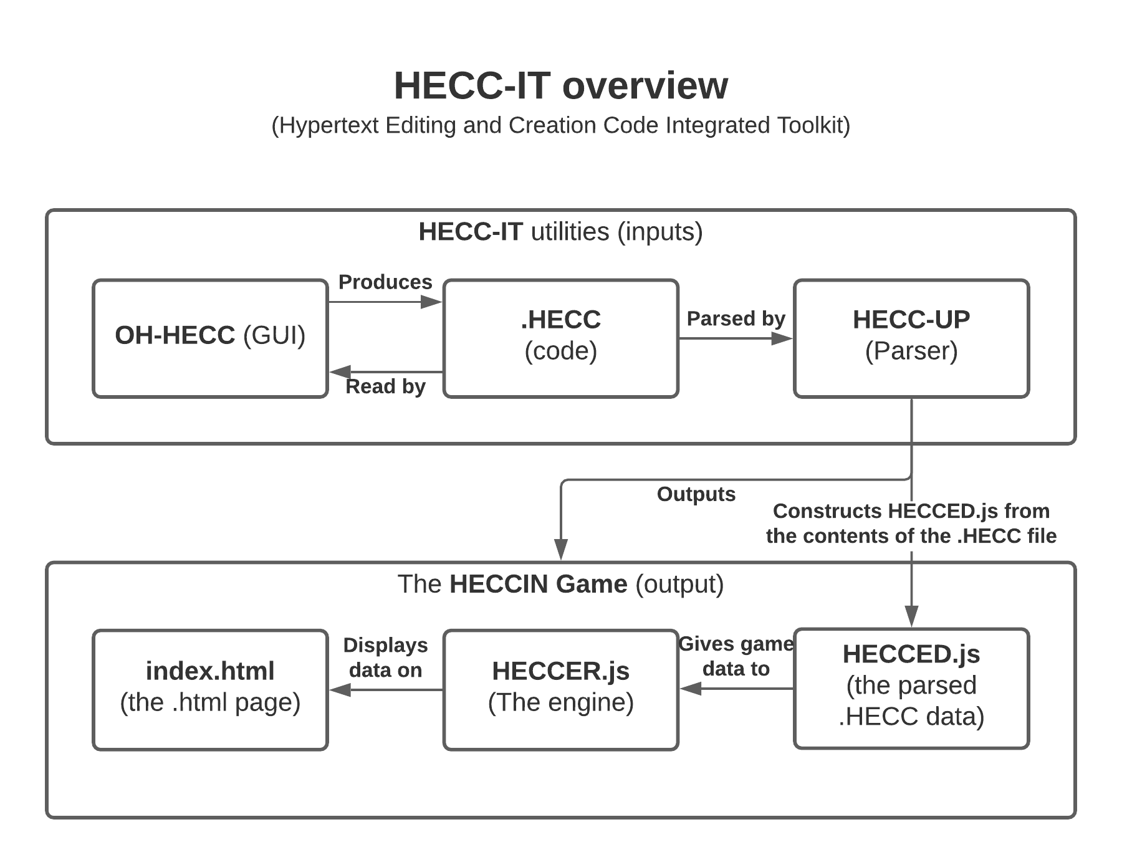

Slide 5
Prep work over the summer
Initial plan
Look at existing hypertext game tools, work out how they work, and use that to guide the design of my tool
A few changes were made to that plan
Found out about the ‘Treaty of Babel’ standard for Interactive Fiction
Started to implement a prototype version of my tool whilst I was trying to plan how it would work
Realized that I needed to look at some academic literature and some existing hypertext games as well
Decided to produce the ‘summary of background reading’ document as well before the start of term

Slide 6
Why am I doing this project?
Why am I doing this now?
What can I bring to the table that nobody else has?
I like making things that others can play around with
Doesn’t involve any specialized hardware/software
Might actually be of some use to somebody
I guess I might be able to use this tool as a decent outlet for some stuff I’ve had on my chest for some time.
This system will allow users to easily swap between using a visual editor and editing the raw data manually, at will, without needing to go through any longwinded conversion processes.

Slide 7
Challenge Week - goals
Encapsulate the metadata processing code into a Metadata object
Ensure my metadata is compliant with the Treaty of Babel standard
Improve the default appearance of index.html
Produce a GUI for HECC-UP
Make a markdown parser within HECC-UP (permitting markdown formatting)
Make HECC-UP escape any special HTML characters in the input
Produce this presentation
Incorporate some unit tests into HECC-UP

Slide 8
Challenge Week – status of the goals
Successes
Failures
Metadata
Improving index.html
GUI
Escape characters
Producing this presentation
Markdown parser
Unit Tests
Only realizing that my project was becoming a spaghetti monster on Thursday
Notes:
Successes
Metadata + index.html: did that on Monday
GUI: did that on Tuesday
Escape characters: did that on Wednesday
Presentation: made this on Thursday
Failures
Markdown: Spent most of Wednesday trying to do that.
Probably going to just use an existing implementation made by someone else instead.
However, I probably need to clean up my HECC-IT code and work out exactly what is going where before I attempt doing that
Unit tests: Didn’t get around to doing that.
The overall design of the Java component of HECC-IT wasn’t very well planned out in advance, so I’ve honestly forgotten where exactly I would pass inputs to and get outputs from.

Slide 9
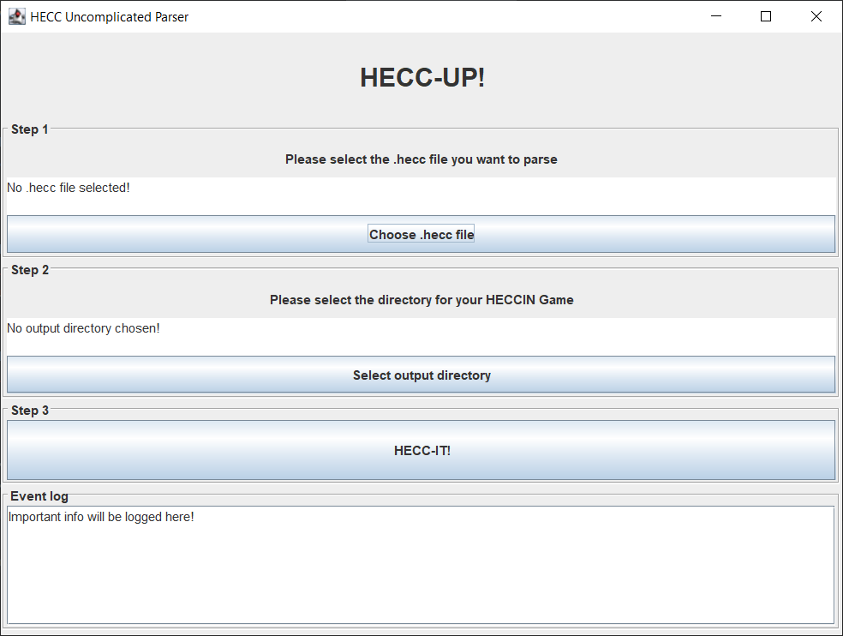
What the program currently looks like
Notes:
It works though, as I’ll demonstrate shortly.

Slide 10
What’s next
Short-term
Tame the Spaghetti Monster
Medium term (Week 11)
Add support for variables to be declared (probably at the start, within metadata)
Create the OH-HECC GUI
Long term
Implement functionality for variables within the HECCIN Game (conditional statements showing/hiding content, updating values of variables, gamestates remembering the state of the variables at that particular point in time, etc)
Notes:
Killing the spaghetti monster:
Go through my code and work out what everything currently does
Work out an appropriate design pattern that I should use
Refactor everything into that pattern

Slide 11
Risk Management
Hardware issues
The hardware I have at my disposal is posing a slight bottleneck to my productivity, however, I’m going to see if the virtual lab stuff can address this problem this weekend.
Maintainability
The aforementioned spaghetti monster has already posed a few problems with development, so I shall be getting rid of that as priority #1, and I shall try to improve the quality of my documentation to avoid this happening again
COVID
Catching it might make it a bit harder for me to get work done, so I’ve been trying to minimize my chances of catching it.

Slide 12
Usage of Gitlab
Everything is on Gitlab.
When I give up for the day/have to leave/etc, I commit my work and push it onto the repo.
Currently at >100 commits
I’ve only really used branches as a way of archiving the state of the repo at particular points in time, because I don’t trust myself to keep track of several active branches at once.

Slide 13
Usage of Jira
I have tried to log work/tasks/etc on Jira as diligently as possible, linking to the appropriate git commit the work I’ve done when logging work
I have been splitting overarching tasks into subtasks, and using epics.
All the summer background prep work issues (all of which are done) have been put into a release, out of the way
Keeping track of statuses of tasks on my Kanban board
Haven’t been using story points, time estimations, and I’ve been inconsistent with my use of priorities and deadlines for tasks.
Notes:
141 hours logged over the summer
https://cseejira.essex.ac.uk/secure/ConfigureReport.jspa?versionId=14012&sortingOrder=least&completedFilter=all&subtaskInclusion=onlySelected&selectedProjectId=15147&reportKey=com.atlassian.jira.jira-core-reports-plugin%3Atime-tracking&atl_token=B9HA-A75A-1MQD-BVTB_4f04fba4db40b5c31eb9257dfd36089480eca8fe_lin&Next=Next
~20-something hours logged this week
https://cseejira.essex.ac.uk/secure/ConfigureReport.jspa?versionId=-1&sortingOrder=least&completedFilter=all&subtaskInclusion=onlySelected&selectedProjectId=15147&reportKey=com.atlassian.jira.jira-core-reports-plugin%3Atime-tracking&atl_token=B9HA-A75A-1MQD-BVTB_4f04fba4db40b5c31eb9257dfd36089480eca8fe_lin&Next=Next
Summer prep work release: https://cseejira.essex.ac.uk/projects/A301034/versions/14012

